Slide 1

Accurate Scoring of Drug Conformations at the Extreme Scale
Boyu Zhang¹, Trilce Estrada², Pietro Cicotti³,
Pavan Balaji⁴, and Michela Taufer¹
¹ University of Delaware
² University of New Mexico
³ San Diego Supercomputer Center
⁴ Argonne National Laboratory

Slide 2
Scalability’s Invisible Enemy
Accurate Scoring of Drug Conformations at the Extreme Scale
Science - Limits - Method - Accuracy - Performance - Conclusions
Peak Performance
From a recent talk of Lucy Nowell, DoE Program Director
(DoE Workflow Workshop, Rockville, MD, April 20-21, 2015)
Our simulations today:
Save all the data to analyze later!
Our simulations at exascale:
Analyze data as they are generated
Save only what is really needed!
IO Bandwidth
Scalability is no longer about
number of FLOPS and cores BUT
about data size and analysis speed

Slide 3
Scalability’s Invisible Enemy
Accurate Scoring of Drug Conformations at the Extreme Scale
Science - Limits - Method - Accuracy - Performance - Conclusions
Peak Performance
From a recent talk of Lucy Nowell, DoE Program Director
(DoE Workflow Workshop, Rockville, MD, April 20-21, 2015)
Our simulations today:
Save all the data to analyze later!
Our simulations at exascale:
Analyze data as they are generated
Save only what is really needed!
IO Bandwidth
Scalability is no longer about
number of FLOPS and cores BUT
about data size and speed of analysis

Slide 4
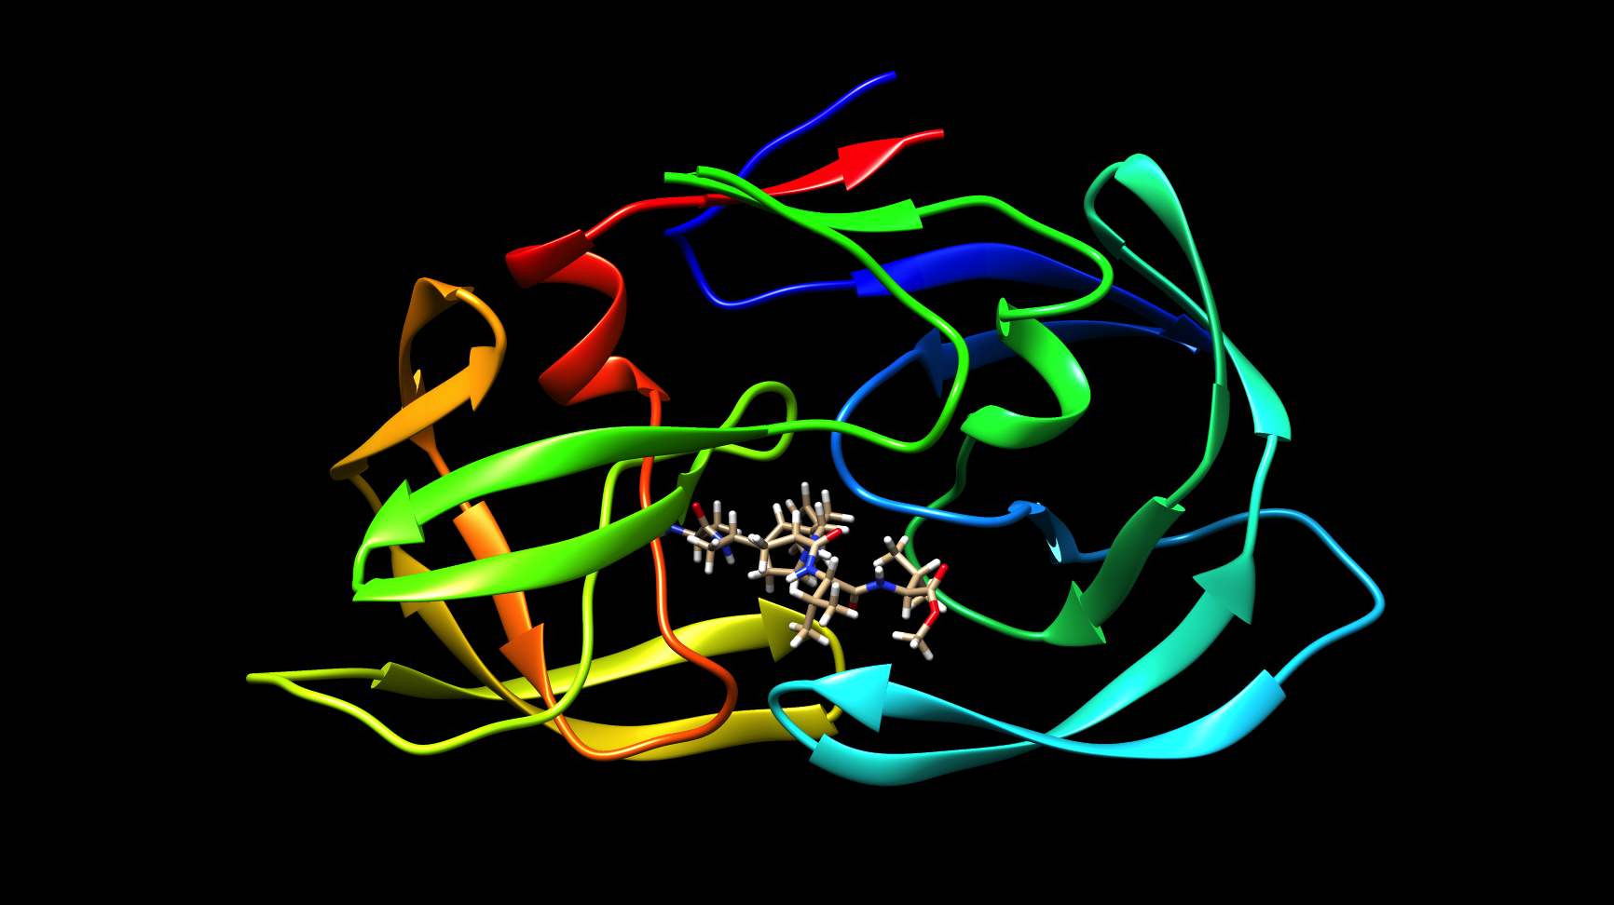
Protein-Ligand Docking Simulations
Accurate Scoring of Drug Conformations at the Extreme Scale
Science - Limits - Method - Accuracy - Performance – Conclusions
M. Taufer, R.S. Armen, J. Chen, P.J. Teller, and C.L. Brooks III. Computational Multi-Scale Modeling in Protein-Ligand Docking. IEEE Engineering in Medicine and Biology Magazine, 28(2): 58 – 69, 2009.

Slide 5
Principles of Drug Action
Accurate Scoring of Drug Conformations at the Extreme Scale
Science - Limits - Method - Accuracy - Performance – Conclusions
Parkinson's: caused by decrease of the neurotransmitter dopamine. Drugs restore the action of dopamine.
Agonist
(binds to
Dopamine
Receptor)
Agonist-
Receptor
Complex
Biochemical signal sent
(turns a pathway on or off)
Agonist
released
Receptor
signal
Receptor
Receptor
Receptor
Schizophrenia: caused by high levels of the neurotransmitter dopamine. Drug blocks excess dopamine from reaching its receptors.
Agonist
Antagonist
Agonist
cannot
bind
If the Antagonist is a better
complementary fit than
Agonist, it may lead to
nearly 100% inhibition
Biochemical signal
not sent
Receptor
Receptor
Receptor
no
signal
Receptor
Courtesy of Roger Armen (TJU)

Slide 6
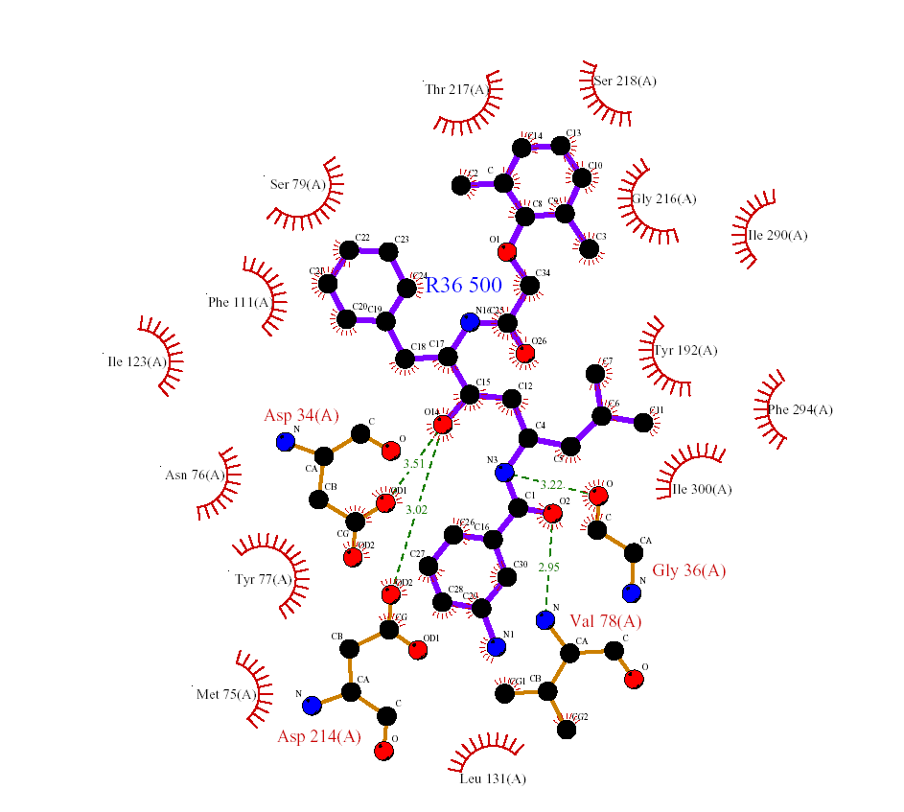

Drug Development Process
Accurate Scoring of Drug Conformations at the Extreme Scale
Science - Limits - Method - Accuracy - Performance - Conclusions
“High-Throughput
Screening Phase”
200,000 - 1,000,000
Ligand types
The experimental drug development process is slow, expensive, and error-prone
}
}
“Hit-to-Lead” Phase
100-500 compounds
}
“Lead Optimization”
1-5 compounds
High-Throughput
Screening
in Wet Lab
active
Testing in cells, tissue
cultures and animal models: assess efficacy and safety
inactive
Clinical Candidate
Clinical Trials
(200-500 million dollars)
Filtering out
Hits and
Hits to Lead
Lead
Optimization
Clustering
Courtesy of Roger Armen (TJU)

Slide 7

Drug Development Process
Accurate Scoring of Drug Conformations at the Extreme Scale
Science - Limits - Method - Accuracy - Performance - Conclusions
“High-Throughput
Screening Phase”
200,000 - 1,000,000
Ligand types
The experimental drug development process is slow, expensive, and error-prone
}
}
“Hit-to-Lead” Phase
100-500 compounds
}
“Lead Optimization”
1-5 compounds
Virtual High-Throughput
Screening
in Computer Lab
active
Testing in cells, tissue
cultures and animal models: assess efficacy and safety
inactive
Clinical Candidate
Clinical Trials
(200-500 million dollars)
Filtering out
Hits and
Hits to Lead
Lead
Optimization
Clustering
Courtesy of Roger Armen (TJU)

Slide 8
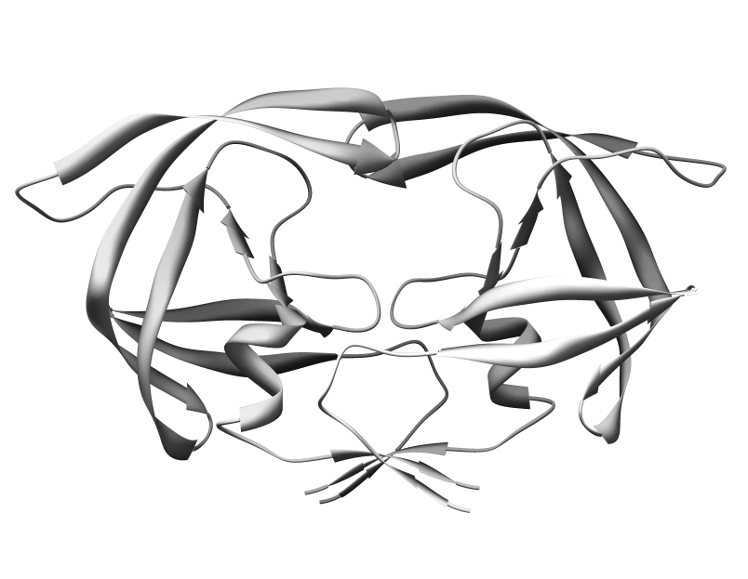
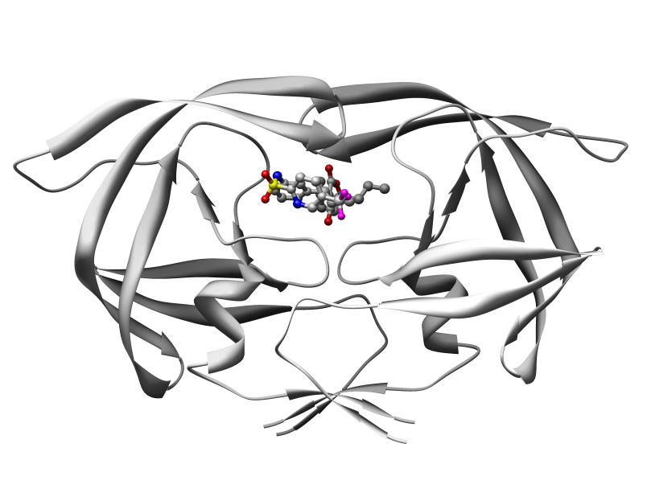
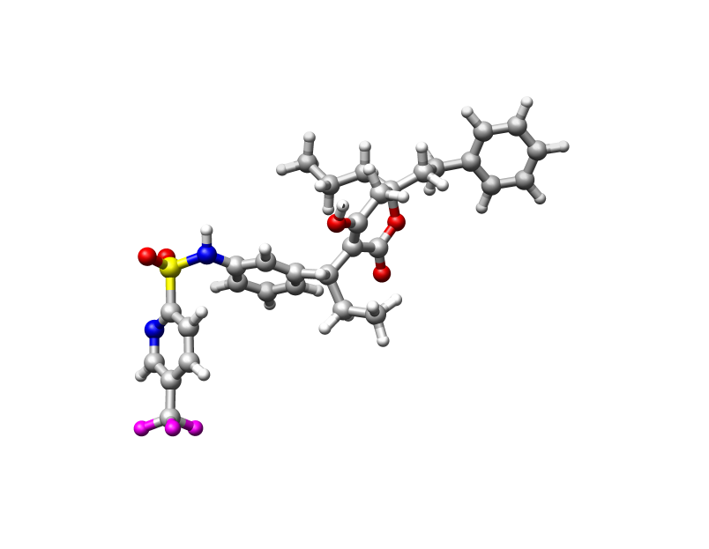
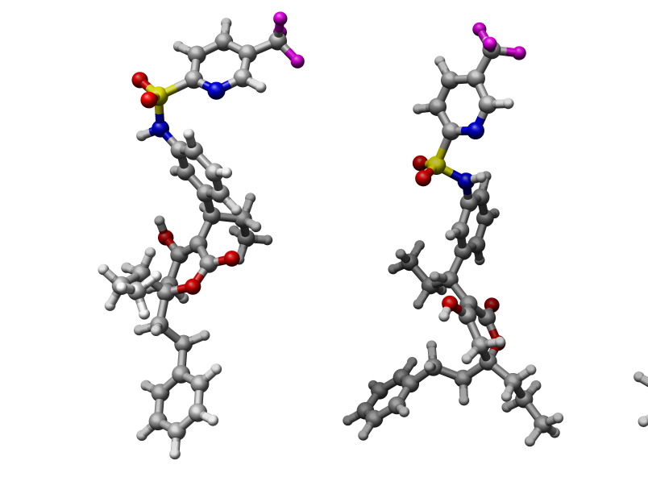
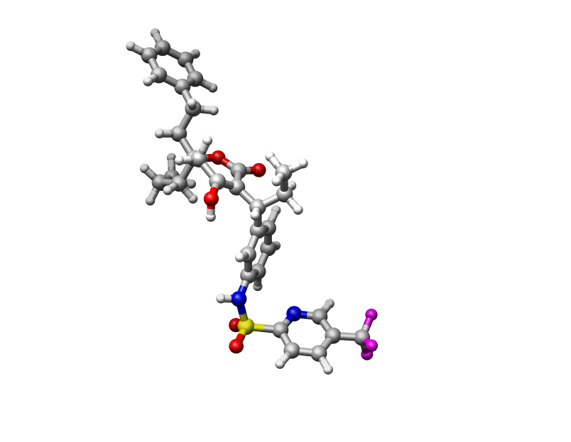
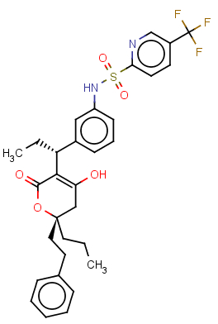
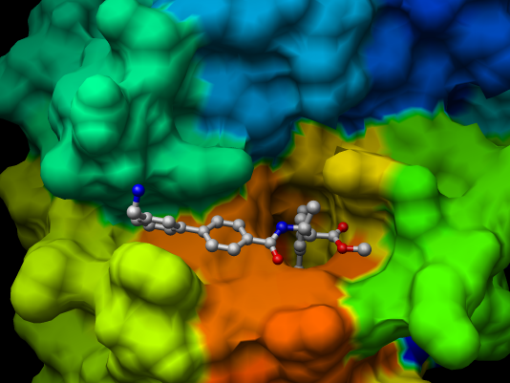
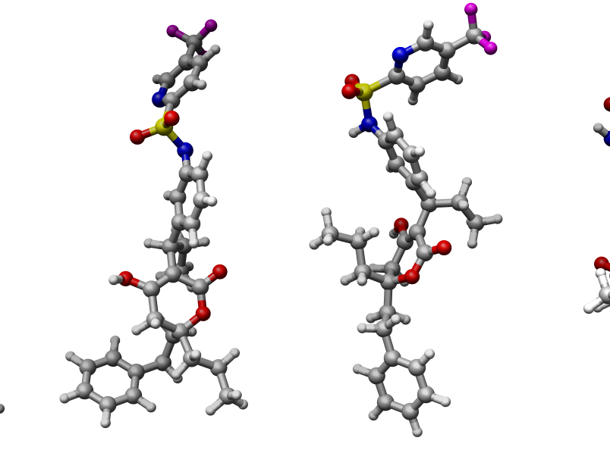
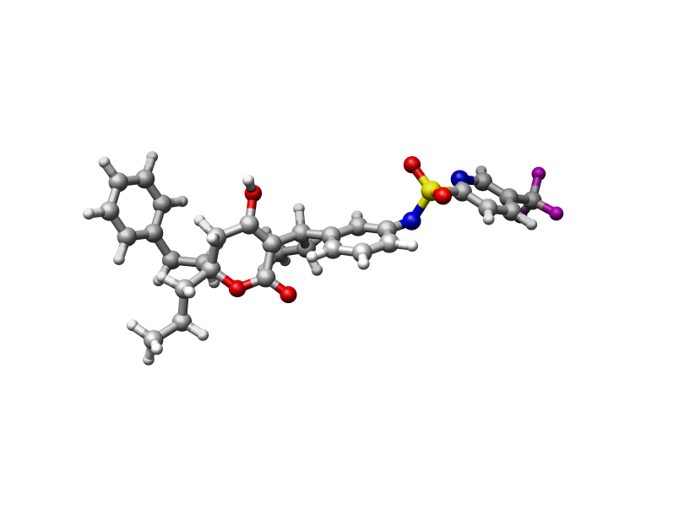
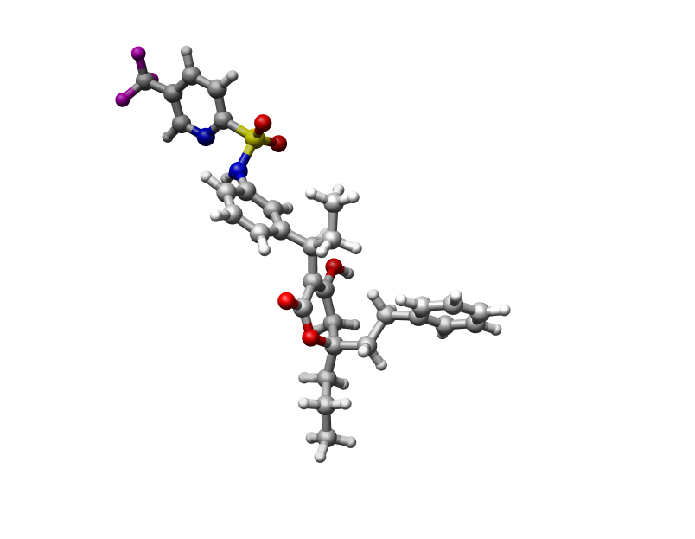
Protein-Ligand Docking Simulations
Accurate Scoring of Drug Conformations at the Extreme Scale
Science - Limits - Method - Accuracy - Performance - Conclusions
Near-native conformations
Model
Initial 3D
Conformation
Select
Well-docked
Ligands
Generate
Random
Conformations
Generate Random
Rotations
Dock onto
Protein
Model
Run
Independent
MD Jobs
M. Taufer, R.S. Armen, J. Chen, P.J. Teller, and C.L. Brooks III. Computational Multi-Scale Modeling in Protein-Ligand Docking. IEEE Engineering in Medicine and Biology Magazine, 28(2): 58 – 69, 2009.

Slide 9
Flops Makers ….
Accurate Scoring of Drug Conformations at the Extreme Scale
Science - Limits - Method - Accuracy - Performance - Conclusions
Model
Initial 3D
Conformation
Select
Well-docked
Ligands
Generate
Random
Conformations
Generate Random
Rotations
Dock onto
Protein
Model
Run
Independent
MD Jobs
M. Taufer, R.S. Armen, J. Chen, P.J. Teller, and C.L. Brooks III. Computational Multi-Scale Modeling in Protein-Ligand Docking. IEEE Engineering in Medicine and Biology Magazine, 28(2): 58 – 69, 2009.

Slide 10
Scalability Killer ….
Accurate Scoring of Drug Conformations at the Extreme Scale
Science - Limits - Method - Accuracy - Performance - Conclusions
Model
Initial 3D
Conformation
Select
Well-docked
Ligands
Generate
Random
Conformations
Generate Random
Rotations
Dock onto
Protein
Model
Run
Independent
MD Jobs
M. Taufer, R.S. Armen, J. Chen, P.J. Teller, and C.L. Brooks III. Computational Multi-Scale Modeling in Protein-Ligand Docking. IEEE Engineering in Medicine and Biology Magazine, 28(2): 58 – 69, 2009.

Slide 11

Perfect Distributed Nature of Data Generation
Accurate Scoring of Drug Conformations at the Extreme Scale
Science - Limits - Method - Accuracy - Performance - Conclusions
Use high-end supercomputers to generate millions of ligand conformations
Protein-ligand docking
Protein-ligand docking

Slide 12
Imperfect Centralized Nature of Data Analysis
Accurate Scoring of Drug Conformations at the Extreme Scale
Science - Limits - Method - Accuracy - Performance - Conclusions
Scoring and selecting well-docked conformations based on:
Minimum energy of ligand conformations: inaccurate due to imperfect modeling in the simulation [Rahaman et al. 2011]
Scalable but inaccurate
Geometry of reduced ligand samples: may be inaccurate since it relies on a “good” sampling approach; waste computation and results [Lorenzen et al. 2007]
Perhaps scalable and probably accurate
Geometry of all ligand conformation: does not scale due to data movement and all-to-all comparison [Estrada et al. 2010]
Not scalable but accurate

Slide 13
Imperfect Centralized Nature of Data Analysis
Accurate Scoring of Drug Conformations at the Extreme Scale
Science - Limits - Method - Accuracy - Performance - Conclusions
Scoring and selecting well-docked conformations based on:
Minimum energy of ligand conformations: inaccurate due to imperfect modeling in the simulation [Rahaman et al. 2011]
Scalable but inaccurate
Geometry of reduced ligand samples: may be inaccurate since it relies on a “good” sampling approach; waste computation and results [Lorenzen et al. 2007]
Perhaps scalable and probably accurate
Geometry of all ligand conformation: does not scale due to data movement and all-to-all comparison [Estrada et al. 2010]
Not scalable but accurate

Slide 14
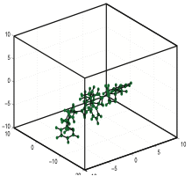
Our Scalable Solution
Accurate Scoring of Drug Conformations at the Extreme Scale
Science - Limits - Method - Accuracy - Performance - Conclusions
Enables in-situ analysis -- on same resources as simulation when data is generated
Execute fast
Fit in memory
Avoid data movement
Near-native conformations
3-D
Data
High-dimensional
Metadata
Low-dimensional
Results
Scientific knowledge
Extract geometries (metadata) concurrently
Search for densest metadata spaces
Is at the intersection of energy-based scalability and geometry-based accuracy
Exhibits up to 400X gain in speedup and 500X in data size

Slide 15
Energy-based Scoring
Energy-based Scoring

Slide 16
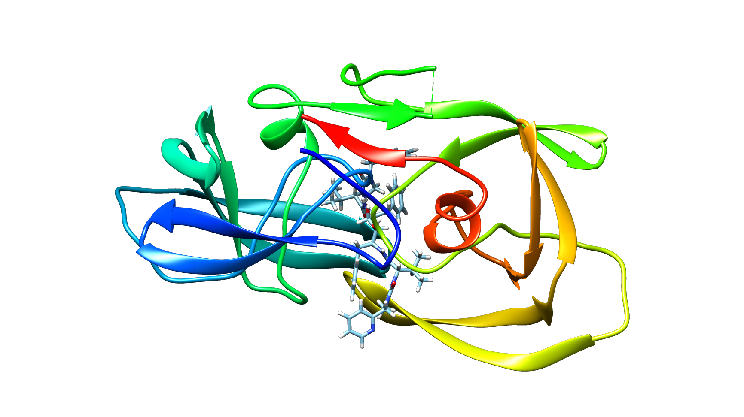
Energy-based Scoring
50
50
50
25
75
25
75
25
75
CPU utilization
Memory utilization
Network utilization

Slide 17
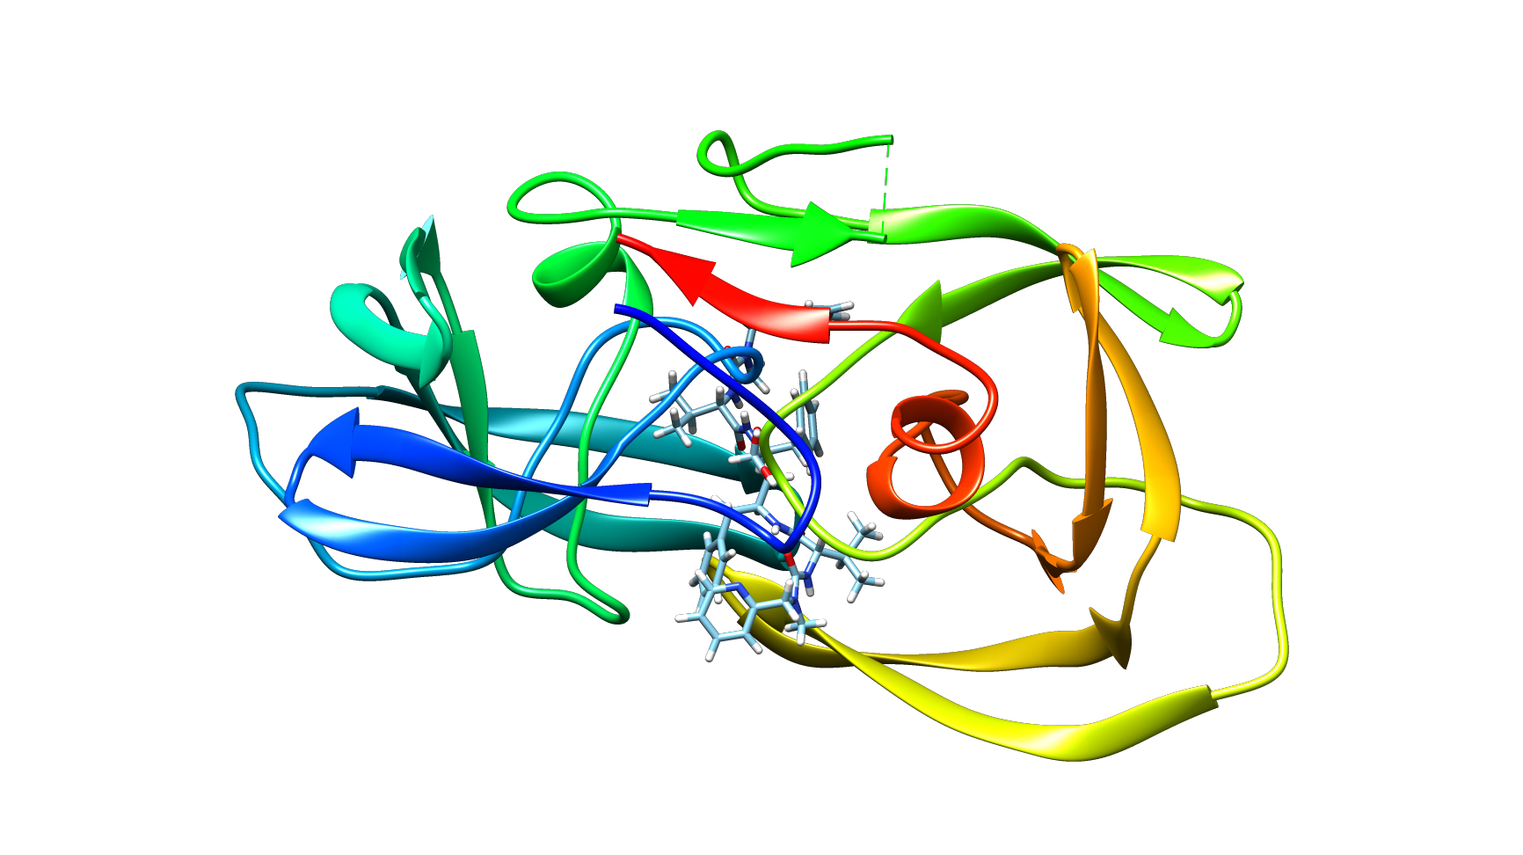
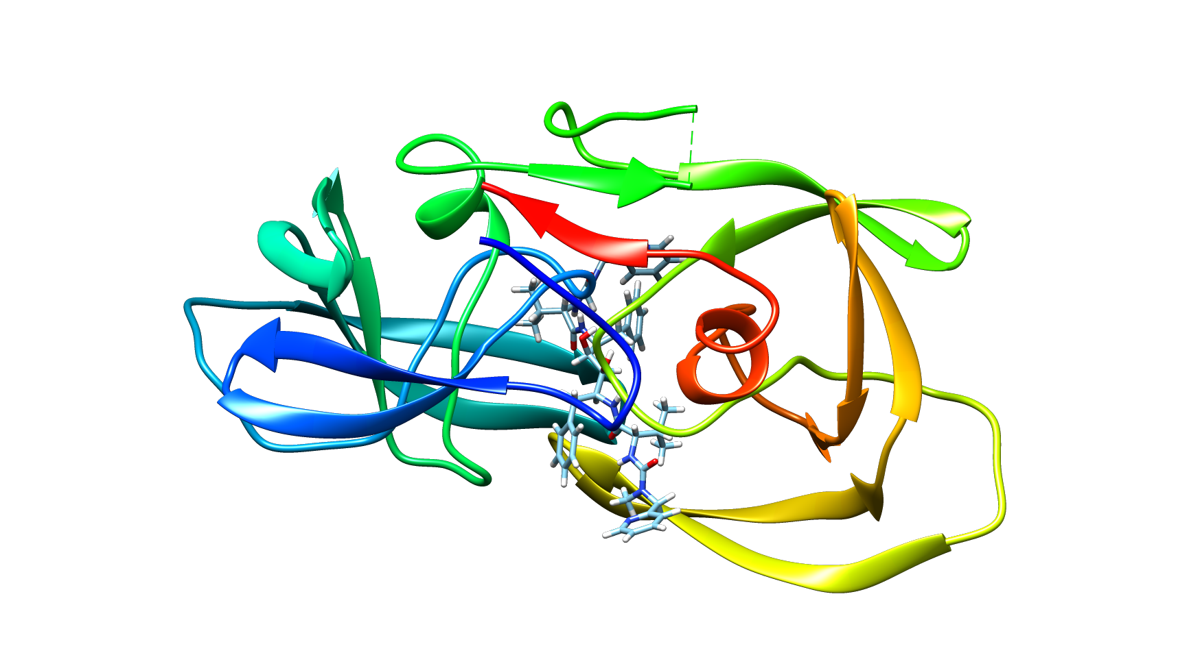
Energy-based Scoring
50
50
50
25
75
25
75
25
75
CPU utilization
Memory utilization
Network utilization

Slide 18
Energy-based Scoring
50
50
50
25
75
25
75
25
75
CPU utilization
Memory utilization
Network utilization

Slide 19
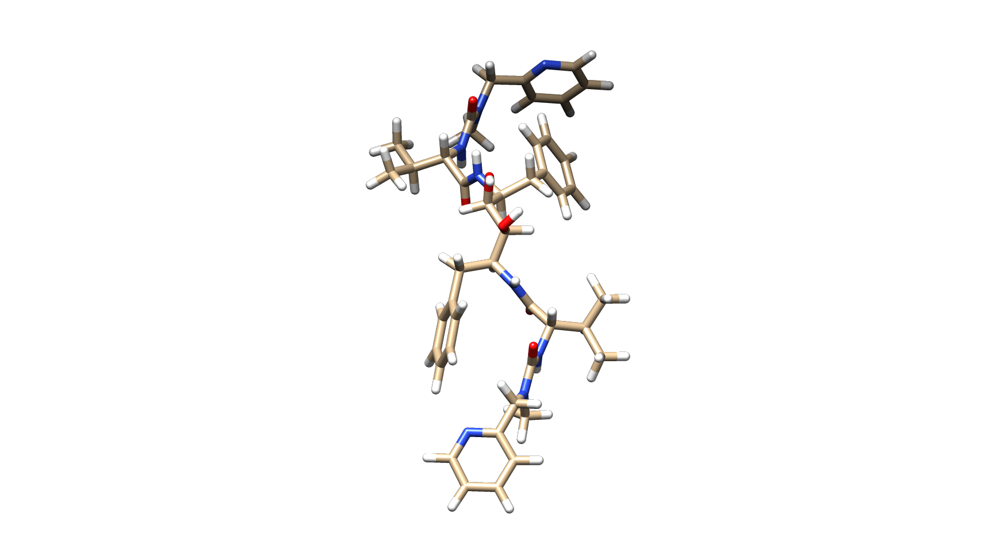
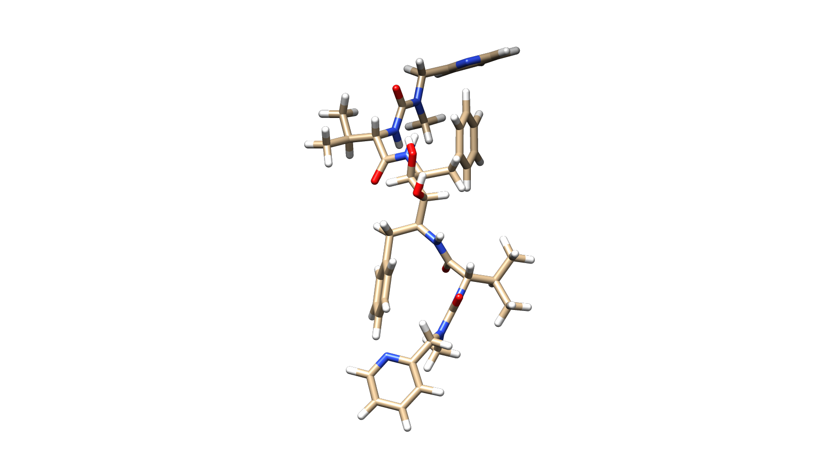
Energy-based Scoring
Energy:
14.7
Energy:
4.9
50
50
50
25
75
25
75
25
75
CPU utilization
Memory utilization
Network utilization

Slide 20
Energy-based Scoring
Energy:
14.7
Energy:
4.9
50
50
50
25
75
25
75
25
75
CPU utilization
Memory utilization
Network utilization

Slide 21


Energy-based Scoring
Energy:
14.7
Energy:
4.9
50
50
50
25
75
25
75
25
75
CPU utilization
Memory utilization
Network utilization

Slide 22
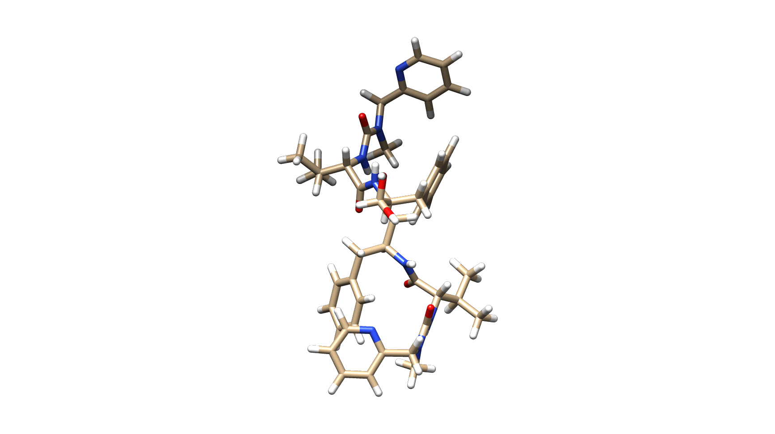
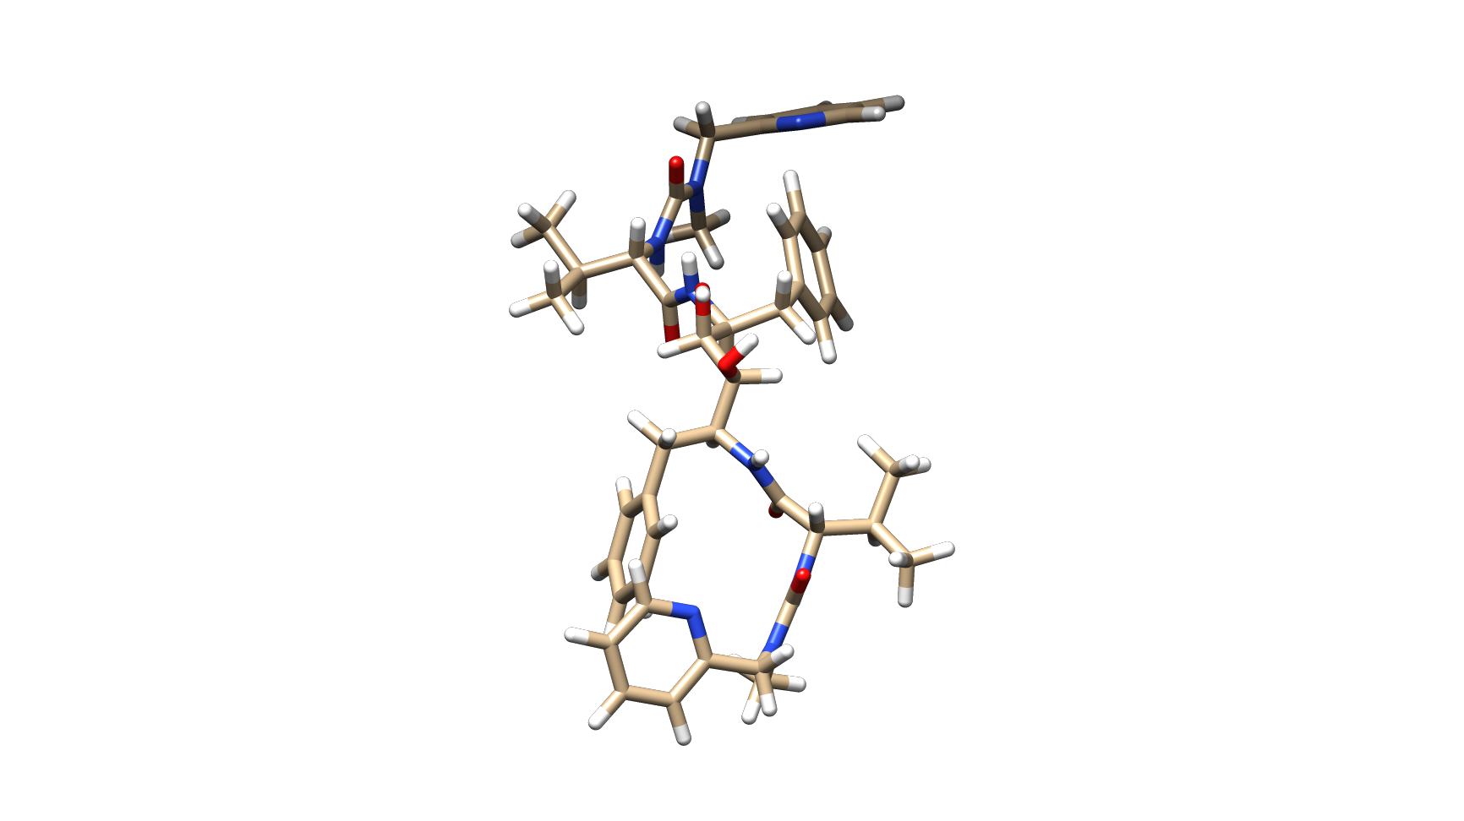
Energy-based Scoring
Energy:
14.7
8.2
Energy:
4.9
-3.3
50
50
50
25
75
25
75
25
75
CPU utilization
Memory utilization
Network utilization

Slide 23
Energy-based Scoring
Energy:
14.7
8.2
Energy:
4.9
-3.3
50
50
50
25
75
25
75
25
75
CPU utilization
Memory utilization
Network utilization

Slide 24
Energy-based Scoring
Energy:
14.7
8.2
Energy:
4.9
-3.3
50
50
50
25
75
25
75
25
75
CPU utilization
Memory utilization
Network utilization

Slide 25
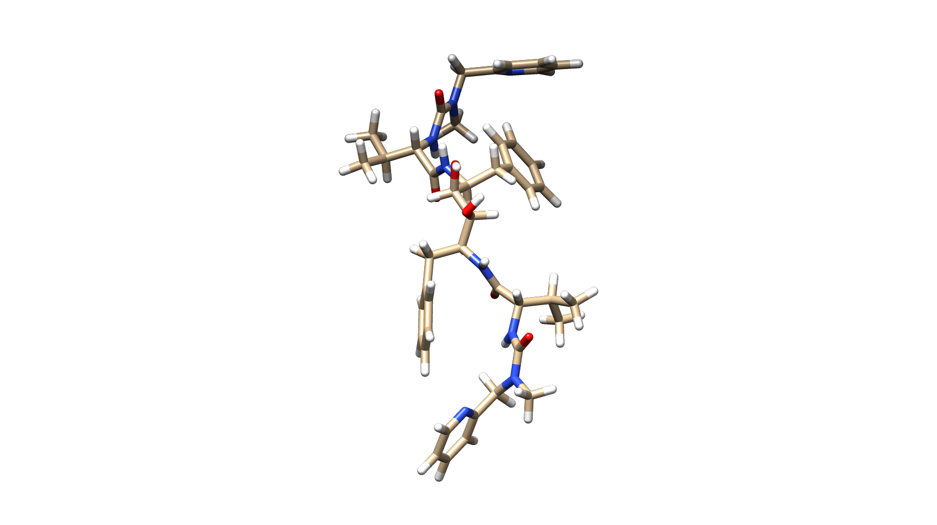
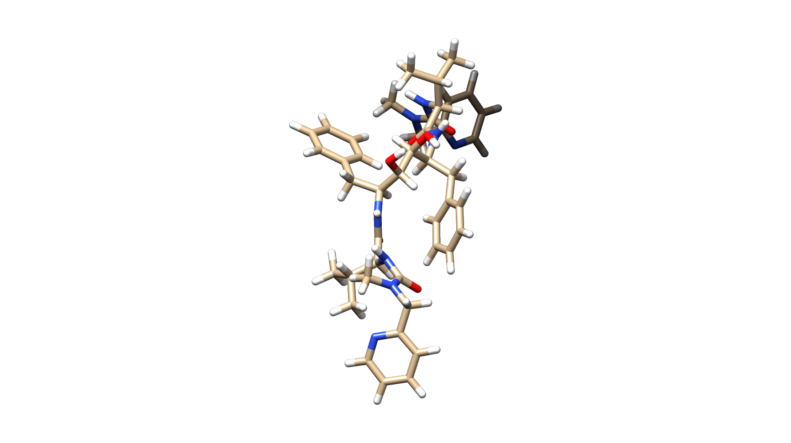
Energy-based Scoring
Energy:
14.7
8.2
-1.5
Energy:
4.9
-3.3
0.7
50
50
50
25
75
25
75
25
75
CPU utilization
Memory utilization
Network utilization

Slide 26
Energy-based Scoring
-1.5
Energy:
14.7
8.2
-1.5
Energy:
4.9
-3.3
0.7
-3.3
50
50
50
25
75
25
75
25
75
CPU utilization
Memory utilization
Network utilization

Slide 27
Energy-based Scoring
-1.5
Energy:
14.7
8.2
-1.5
Energy:
4.9
-3.3
0.7
-3.3
50
50
50
25
75
25
75
25
75
CPU utilization
Memory utilization
Network utilization

Slide 28
Energy-based Scoring
Energy:
14.7
8.2
-1.5
-1.5
-3.3
Energy:
4.9
-3.3
0.7
50
50
50
25
75
25
75
25
75
CPU utilization
Memory utilization
Network utilization

Slide 29
Energy-based Scoring
Energy:
14.7
8.2
-1.5
-1.5
-3.3
Energy:
4.9
-3.3
0.7
50
50
50
25
75
25
75
25
75
CPU utilization
Memory utilization
Network utilization

Slide 30
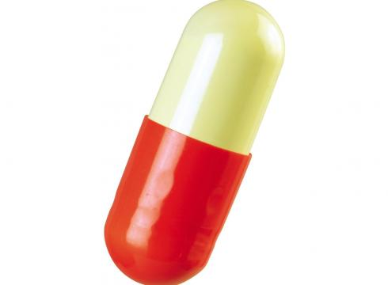
Energy-based Scoring
Energy:
14.7
8.2
-1.5
-1.5
-3.3
Energy:
4.9
-3.3
0.7
50
50
50
25
75
25
75
25
75
CPU utilization
Memory utilization
Network utilization
Accuracy

Slide 31
Geometry-based Clustering
Geometry-based Clustering

Slide 32
Geometry-based Clustering
50
50
50
25
75
25
75
25
75
CPU utilization
Memory utilization
Network utilization

Slide 33
Geometry-based Clustering
50
50
50
25
75
25
75
25
75
CPU utilization
Memory utilization
Network utilization

Slide 34
Geometry-based Clustering
50
50
50
25
75
25
75
25
75
CPU utilization
Memory utilization
Network utilization

Slide 35
Geometry-based Clustering
50
50
50
25
75
25
75
25
75
CPU utilization
Memory utilization
Network utilization

Slide 36
Geometry-based Clustering
50
50
50
25
75
25
75
25
75
CPU utilization
Memory utilization
Network utilization

Slide 37
Geometry-based Clustering
50
50
50
25
75
25
75
25
75
CPU utilization
Memory utilization
Network utilization

Slide 38
Geometry-based Clustering
50
50
50
25
75
25
75
25
75
CPU utilization
Memory utilization
Network utilization

Slide 39
Geometry-based Clustering
50
50
50
25
75
25
75
25
75
CPU utilization
Memory utilization
Network utilization

Slide 40
Geometry-based Clustering
50
50
50
25
75
25
75
25
75
CPU utilization
Memory utilization
Network utilization

Slide 41
Geometry-based Clustering
50
50
50
25
75
25
75
25
75
CPU utilization
Memory utilization
Network utilization

Slide 42
Geometry-based Clustering
50
50
50
25
75
25
75
25
75
CPU utilization
Memory utilization
Network utilization

Slide 43
Geometry-based Clustering
50
50
50
25
75
25
75
25
75
CPU utilization
Memory utilization
Network utilization

Slide 44
Geometry-based Clustering
50
50
50
25
75
25
75
25
75
CPU utilization
Memory utilization
Network utilization

Slide 45
Geometry-based Clustering
50
50
50
25
75
25
75
25
75
CPU utilization
Memory utilization
Network utilization

Slide 46
Geometry-based Clustering
50
50
50
25
75
25
75
25
75
CPU utilization
Memory utilization
Network utilization

Slide 47
Geometry-based Clustering
50
50
50
25
75
25
75
25
75
CPU utilization
Memory utilization
Network utilization

Slide 48
Geometry-based Clustering
50
50
50
25
75
25
75
25
75
CPU utilization
Memory utilization
Network utilization

Slide 49
Geometry-based Clustering
50
50
50
25
75
25
75
25
75
CPU utilization
Memory utilization
Network utilization

Slide 50
Geometry-based Clustering
50
50
50
25
75
25
75
25
75
CPU utilization
Memory utilization
Network utilization

Slide 51
Geometry-based Clustering
RMSD
50
50
50
25
75
25
75
25
75
CPU utilization
Memory utilization
Network utilization

Slide 52
Geometry-based Clustering
50
50
50
25
75
25
75
25
75
CPU utilization
Memory utilization
Network utilization

Slide 53
Geometry-based Clustering
RMSD
50
50
50
25
75
25
75
25
75
CPU utilization
Memory utilization
Network utilization

Slide 54
Geometry-based Clustering
50
50
50
25
75
25
75
25
75
CPU utilization
Memory utilization
Network utilization

Slide 55
Geometry-based Clustering
…. after (too) many comparisons …..

Slide 56
Geometry-based Clustering
50
50
50
25
75
25
75
25
75
CPU utilization
Memory utilization
Network utilization

Slide 57
Geometry-based Clustering
50
50
50
25
75
25
75
25
75
CPU utilization
Memory utilization
Network utilization

Slide 58
Geometry-based Clustering
50
50
50
25
75
25
75
25
75
CPU utilization
Memory utilization
Network utilization

Slide 59
Geometry-based Clustering
50
50
50
25
75
25
75
25
75
CPU utilization
Memory utilization
Network utilization
Accuracy

Slide 60
Density-based Metadata Search

Slide 61
Density-based metadata search
50
50
50
25
75
25
75
25
75
CPU utilization
Memory utilization
Network utilization

Slide 62
Density-based metadata search
50
50
50
25
75
25
75
25
75
CPU utilization
Memory utilization
Network utilization

Slide 63
Density-based metadata search
50
50
50
25
75
25
75
25
75
CPU utilization
Memory utilization
Network utilization

Slide 64
Density-based metadata search
Protein pocket
50
50
50
25
75
25
75
25
75
CPU utilization
Memory utilization
Network utilization

Slide 65
Density-based metadata search
Protein pocket
50
50
50
25
75
25
75
25
75
CPU utilization
Memory utilization
Network utilization

Slide 66
Density-based metadata search
Protein pocket
50
50
50
25
75
25
75
25
75
CPU utilization
Memory utilization
Network utilization

Slide 67
Density-based metadata search
50
50
50
25
75
25
75
25
75
CPU utilization
Memory utilization
Network utilization

Slide 68
Density-based metadata search
50
50
50
25
75
25
75
25
75
CPU utilization
Memory utilization
Network utilization

Slide 69
Density-based metadata search
50
50
50
25
75
25
75
25
75
CPU utilization
Memory utilization
Network utilization

Slide 70
Density-based metadata search
50
50
50
25
75
25
75
25
75
CPU utilization
Memory utilization
Network utilization

Slide 71
Density-based metadata search
50
50
50
25
75
25
75
25
75
CPU utilization
Memory utilization
Network utilization

Slide 72
Density-based metadata search
50
50
50
25
75
25
75
25
75
CPU utilization
Memory utilization
Network utilization

Slide 73
Density-based metadata search
50
50
50
25
75
25
75
25
75
CPU utilization
Memory utilization
Network utilization

Slide 74
Density-based metadata search
Ligands with similar geometries are mapped to close metadata points
50
50
50
25
75
25
75
25
75
CPU utilization
Memory utilization
Network utilization

Slide 75
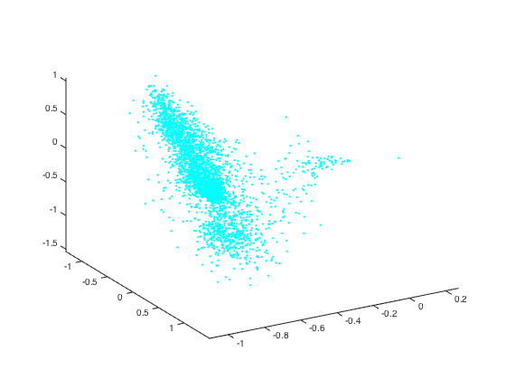
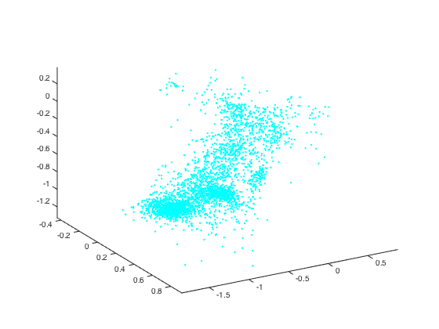
Density-based metadata search
Search == identify the densest metadata region
across all the nodes
50
50
50
25
75
25
75
25
75
CPU utilization
Memory utilization
Network utilization

Slide 76
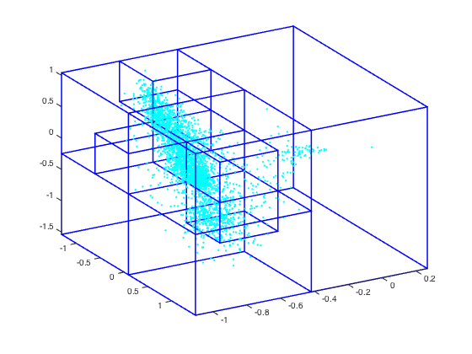
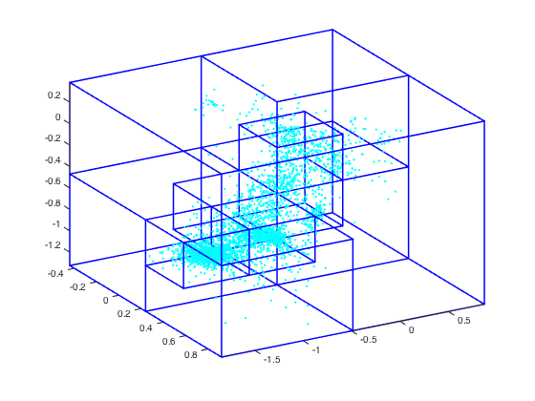
Density-based metadata search
Build local octrees and identify the global deepest densest octant
50
50
50
25
75
25
75
25
75
CPU utilization
Memory utilization
Network utilization

Slide 77
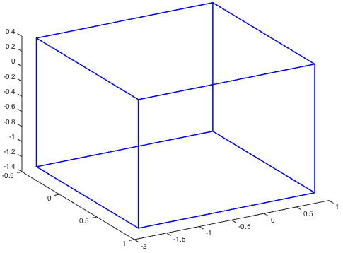
Density-based metadata search
300
100
200
38
62
150
90
60
277
142
135
50
50
50
52
90
85
50
25
75
25
75
25
75
40
50
42
43
CPU utilization
Memory utilization
Network utilization

Slide 78
Density-based metadata search
300
100
200
38
62
150
90
60
277
142
135
52
90
85
50
50
50
50
75
75
75
40
50
42
43
25
25
25
CPU utilization
Memory utilization
Network utilization

Slide 79
Density-based metadata search
300
277
142
135
100
200
52
90
150
38
62
85
50
40
42
43
50
90
60
50
50
50
25
75
25
75
25
75
CPU utilization
Memory utilization
Network utilization

Slide 80
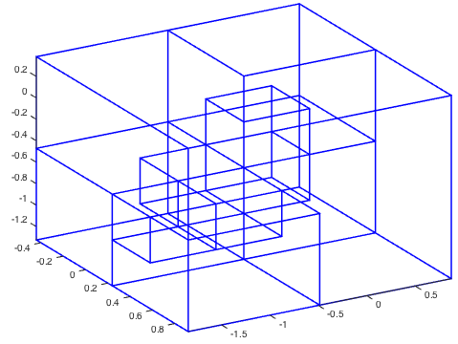
Density-based metadata search
50
50
50
25
75
25
75
25
75
CPU utilization
Memory utilization
Network utilization

Slide 81

Density-based metadata search
! (Exist one octant with
density <= T_{threshold})
50
50
50
25
75
25
75
25
75
CPU utilization
Memory utilization
Network utilization

Slide 82
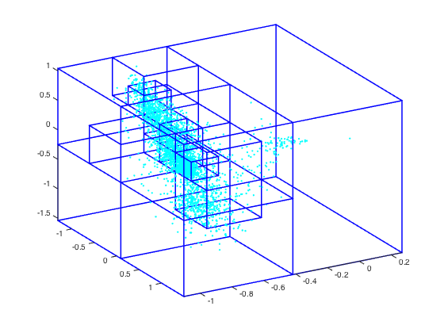
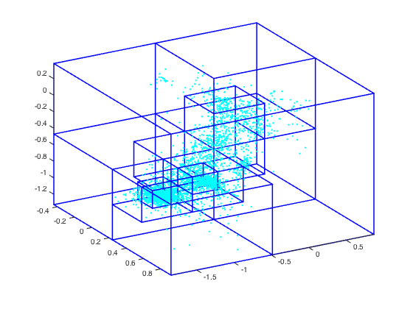
Density-based metadata search
50
50
50
25
75
25
75
25
75
CPU utilization
Memory utilization
Network utilization

Slide 83
Density-based metadata search
300
100
200
38
62
150
90
60
277
142
135
50
50
50
52
90
85
50
25
75
25
75
25
75
40
50
42
43
CPU utilization
Memory utilization
Network utilization

Slide 84
Density-based metadata search
300
100
200
38
62
150
90
60
277
142
135
52
90
85
50
50
50
50
40
50
42
43
25
75
25
75
25
75
CPU utilization
Memory utilization
Network utilization

Slide 85
Density-based metadata search
300
277
142
135
100
200
52
85
50
38
90
62
150
40
50
90
60
42
43
50
50
50
25
75
25
75
25
75
CPU utilization
Memory utilization
Network utilization

Slide 86
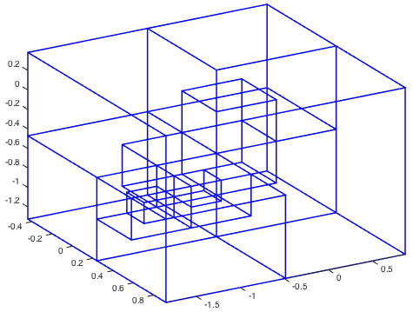
Density-based metadata search
50
50
50
25
75
25
75
25
75
CPU utilization
Memory utilization
Network utilization

Slide 87
Density-based metadata search
50
50
50
25
75
25
75
25
75
CPU utilization
Memory utilization
Network utilization

Slide 88
Density-based metadata search
50
50
50
25
75
25
75
25
75
CPU utilization
Memory utilization
Network utilization
Accuracy

Slide 89
Integration into MapReduce
Accurate Scoring of Drug Conformations at the Extreme Scale
Science - Limits - Method - Accuracy - Performance - Conclusions
Map
Map
Reduce
Reduce
Map
Reduce
Map
Reduce
Map
Reduce
Map
Reduce
Map
Reduce
Map
Reduce

Slide 90
Accuracy
Accurate Scoring of Drug Conformations at the Extreme Scale
Science - Limits - Method - Accuracy - Performance - Conclusions
Datasets
56 protein-ligand complexes
Each docking simulation samples ~210K conformations
Scoring methods:
Energy-based scoring, geometry-based clustering, and density-based metadata search

Slide 91
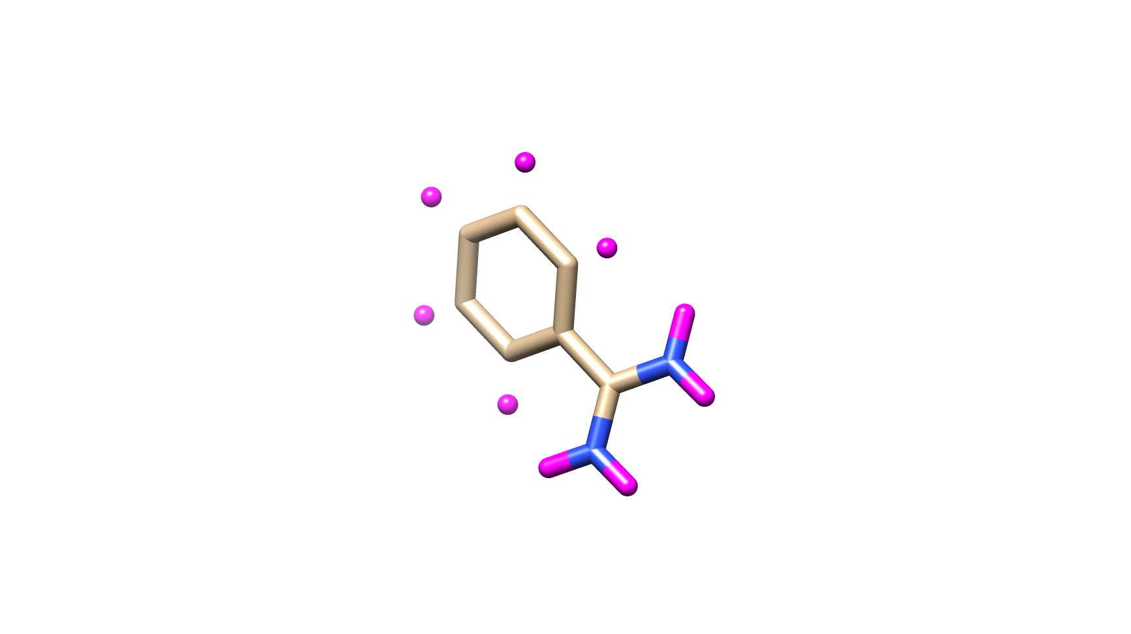
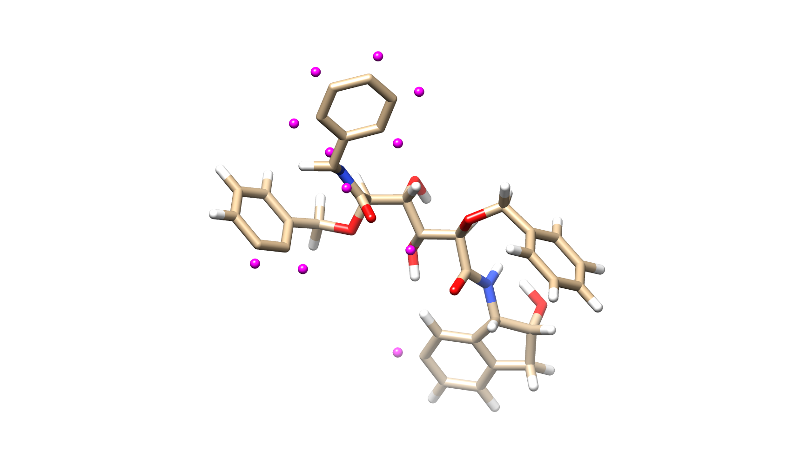
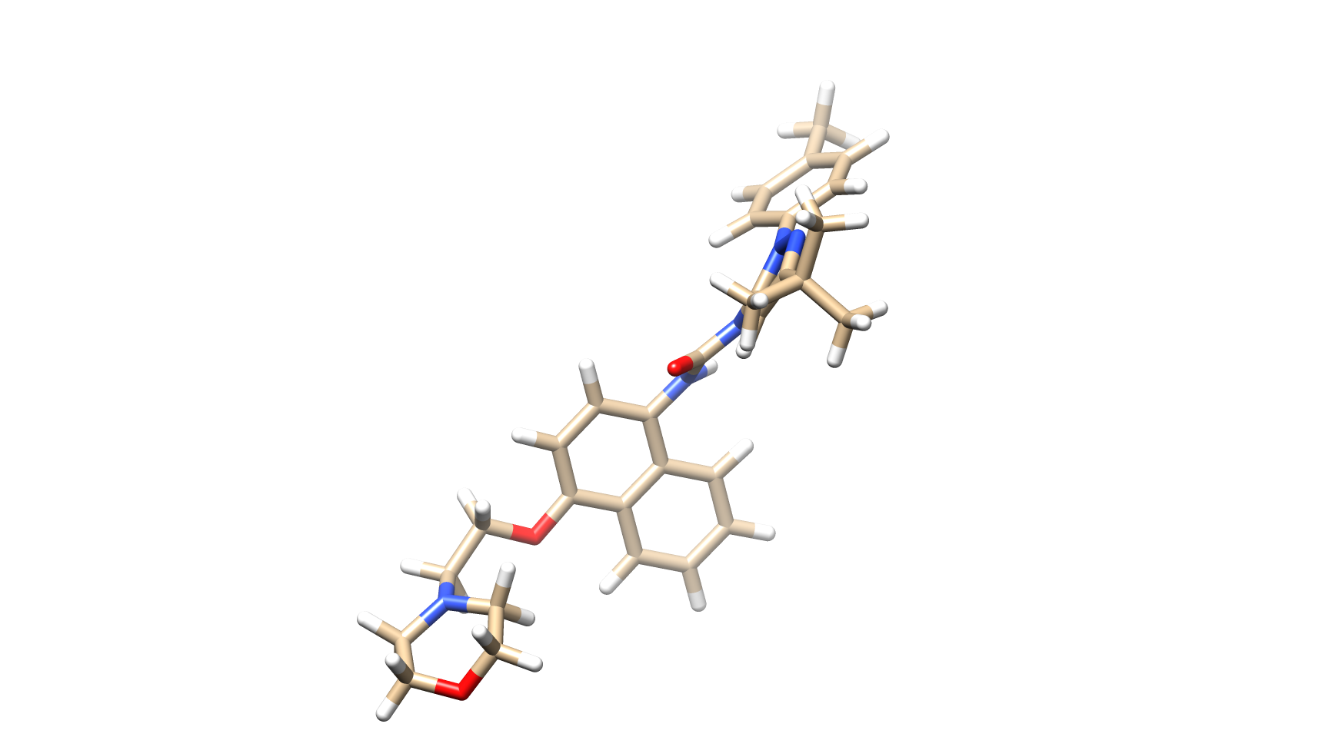
Accuracy
Accurate Scoring of Drug Conformations at the Extreme Scale
Science - Limits - Method - Accuracy - Performance - Conclusions
Trypsin: 23 ligands
Representative: 1c5p
HIV: 21 ligands
Representative: 1d4h
P38alpha: 12 ligands
Representative: 1kv2
Geometry-based
Energy-based
Notes:
Percentage of ligands in which individual method accurately identifies the near-native conformation

Slide 92
Performance
Accurate Scoring of Drug Conformations at the Extreme Scale
Science - Limits - Method - Accuracy - Performance - Conclusions
Datasets:
1dif ligand-HIV protease datasets ranging from 512 MB to 2 TB – i.e., from 200K conformations and 800 million conformations, respectively
Platforms:
Dedicated 8 node (64 cores) cluster at UD - each with two Xeon 2.5GHz quad-core processors, 48GB RAM, DDR InfiniBand
Shared 256 nodes (2048 cores) on Fusion at ANL - 2.6GHz dual-socket, quad-core Xeon processor, 36GB of RAM, QDR InfiniBand
Scoring methods:
Optimized hierarchical c-fuzzy geometry-based clustering [1]
Our density-based metadata search
[1] T. Estrada, R. Armen, and M. Taufer. Automatic Selection of Near-Native Protein-Ligand Conformations using a Hierarchical Clustering and Volunteer Computing. In Proc. of ACM-BCB, 2010.

Slide 93
Performance
Accurate Scoring of Drug Conformations at the Extreme Scale
Science - Limits - Method - Accuracy - Performance - Conclusions
Geometry-based clustering
Density-based metadata search
Execution time (second)
Data size / number of nodes

Slide 94
Performance: Gain in Speedup
Accurate Scoring of Drug Conformations at the Extreme Scale
Science - Limits - Method - Accuracy - Performance - Conclusions
Geometry-based clustering
Density-based metadata search
Execution time (second)
Data size / number of nodes
Our method achieves 400X speedup compared with centralized hierarchical clustering.

Slide 95
Performance: Gain in Data Size
Accurate Scoring of Drug Conformations at the Extreme Scale
Science - Limits - Method - Accuracy - Performance - Conclusions
Geometry-based clustering
Density-based metadata search
Execution time (second)
Data size / number of nodes
Our method can analyze 500X larger datasets.

Slide 96
Conclusion and Future Work
Accurate Scoring of Drug Conformations at the Extreme Scale
Science - Limits - Method - Accuracy - Performance - Conclusions
The study of scalability is no longer about flops and cores but about data size and enabled scientific discovery
We present a scalable and accurate method for scoring and selecting drug candidates in large distributed protein-ligand docking datasets
Our method achieves far higher accurate results compared with energy-based methods
Our method is ~400X faster and can analyze ~500X larger datasets compared with geometry-based clustering methods

Slide 97
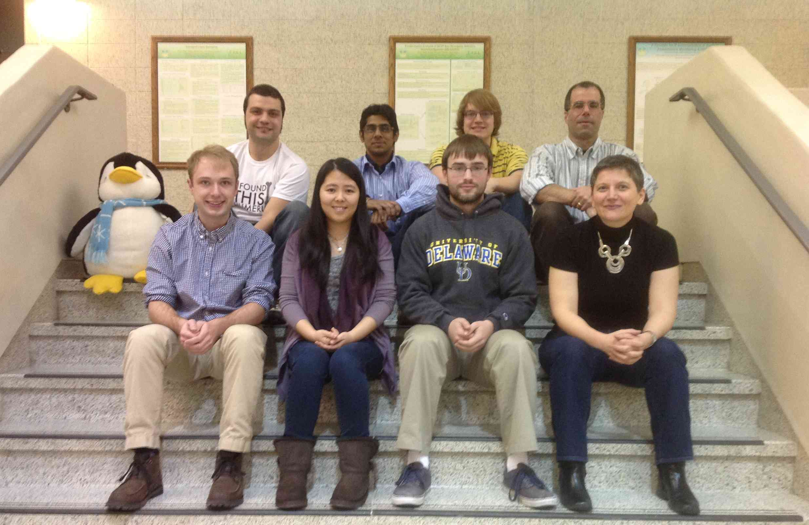


Acknowledgements
GCLab members
Collaborators
Roger Armen (TJU)
Pavan Balaji (ANL)
Pietro Cicotti (SDSC)
Trilce Estrada (UNM)
Boyu Zhang (UD)
Special thanks to:
Docking@Home project for providing the dataset for the tests
Sponsors:

